Slide 1

海洋微生物学及实验
2024-2025学年 冬第一周

Slide 2
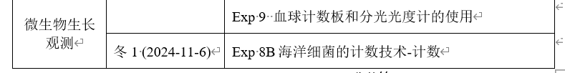
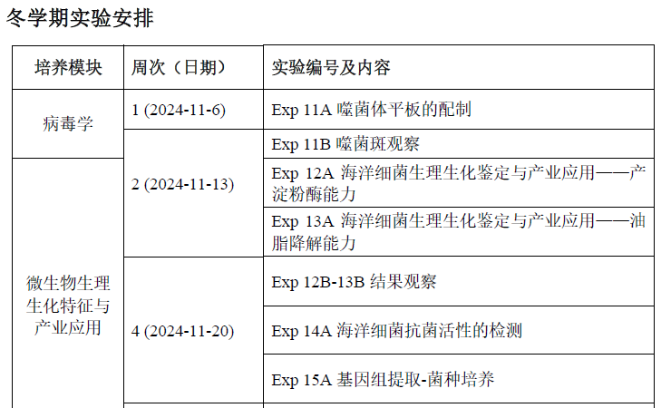

Slide 3
EXPERIMENT 8: Detection of colony-forming unit (CFU) 菌落形成单位
Exp. 8A
Prepare serial dilutions and spread for detecting CFU.
Exp. 8B
METHODS
1. Count the number of colonies in each plate you spread – check with a demonstrator if you think any plates are too crowded to be counted, as high numbers can sometimes be estimated.
2. Tabulate your results in Worksheet 8.

Slide 4
本实验CFU计数：
合适的稀释度 → 合适的CFU数量（30-300）
分区数CFU
精准计算CFU：
合适的稀释度 → 合适的CFU数量
平行样（至少3个平板）

Slide 5
Exp. 8 - 9
Exp. 8
Detection of colony-forming unit (CFU)
只计活菌，但流程复杂、耗时长
Exp. 9 Methods of counting microbes-total cell counts
Neubauer Haemocytometer (血球计数板)
Spectrophotometer (分光光度计)
计所有菌，流程相对简单，但无法计数活菌量

Slide 6
EXPERIMENT 11: PLAQUE ASSAY OF BACTERIOPHAGES
Exp 11A 噬菌体平板的配制
噬菌体的噬菌斑测定
Viruses are commonly characterized according to the type of cell they infect.
Animal viruses; plant viruses; bacterial viruses
What is the host of phage T4?
Bacteriophages are among the most common and diverse entities in the biosphere.
Plaques (噬菌斑) are produced because the virus does not infect all of the host cells. Uninfected cells grow and form a lawn covering the plate. Infected cells lyse, release phages which infect nearby cells to form a clear area in the lawn.
The drop-on-plate plaque assay is used to determine the titer (效价) of a phage stock, which is given as plaque forming units/mL (pfu/mL).
pfu/mL = the number of phages in the stock ?

Slide 7
OBJECTIVES
At the end of this experiment you should:
Understand the principle of the phage plaque assay
Be able to calculate the titer of a phage stock
EXPERIMENT 11A
Materials In the sterile hood
E. coli ATCC 11303 O/N broth culture (Ec) ×1 tube
E. coli phage T4 stock (T4) ×1 tube
Sterile phage buffer in 15 mL tube (Buffer) ×1 tubes
1.5 mL sterile tube several
Pipette and tips (1 mL, 200 μL and 10 μL)
Nutrient agar plate ×6
20 mL/100 mL flask pre-melted (60 ºC) overlay agar in oven (烘箱) ×1

Slide 8

Step 1: Label each plate (×6) as in fig11.1.
Step 2 : Making double-layer NA plate (×6) ！
Step 3 : Serial dilution of T4 using Buffer. Pipetting up and down to mix completely.
Step 4: Add 10 μL drops of phage onto labelled double-layer plate (duplicate for each dilution).

Slide 9

Step 2. Making double-layer NA plate for plaque assay.
2 mL E. coli B culture (Ec)
Mix evenly by inverting ( Do not vortex)
50 mL pre-melted overlay agar
Solid NA plate (NA)
Pour about 3 mL overlay agar for each NA plate quickly, as agar will start to solidify at room temperature.
If overlay has lumps or uneven surface, repeat on new NA plate.
Allow to set for 2-3 min in sterile hood with air flow.
Double-layer NA plate

Slide 10

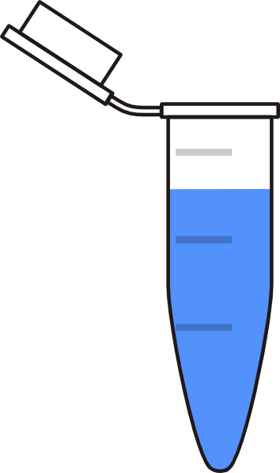

Step 3 : Serial dilution of T4 using Buffer. Pipetting up and down to mix completely.
Step 4: Add 10 μL drops of phage onto labelled double-layer plate (duplicate for each dilution).
Set at the plates in the hood for 5 min without air flow and moving.
5-fold
5-fold
Phage stock
(T4)
10 μL drop
5-fold
25-fold
Each dilution should be more than 30 μL
** Teaching assistant will transfer your plates to incubate at 37 °C. After 4-5 hours, the plaques appear.

